Slide 1
Be A Wise Host in Airbnb
Happy Data

Slide 2
Can you make money by Airbnb?
There are 28533 hosts in the New York City.
28533
There are 3840 millions people in USA using Airbnb when they travel.
3840M
The profit you earn from renting house on Airbnb is 30% higher than the profit of original leasing.
30%
Yes! You can!

Slide 3
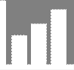




How to maximize your profit?
01
Find Worthy Neighbourhood
02
Choose the Best House-type
03
Price Your House
04
Describe Your House
Notes:
3

Slide 4
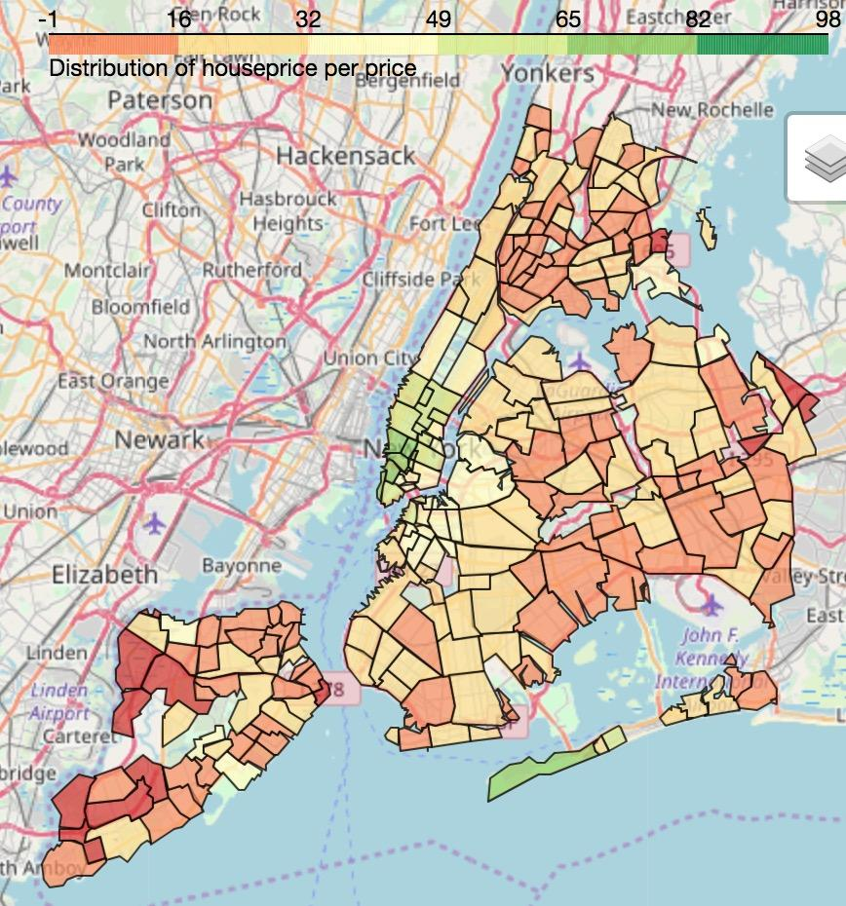
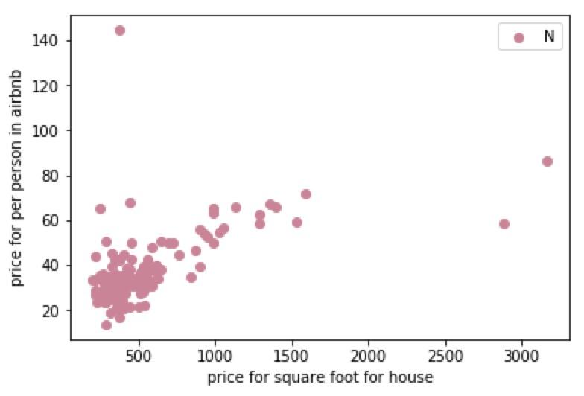
Worthy Neighborhood
The neighborhood which you can get the highest profits through leasing in Airbnb
Low House Price & High Rent Price
*
belle harbor
*
*
Find three profitable neighborhoods
by comparing house price and feasible rental
Find one of it with higher rate of occupacity
according to the number of reviews per month

Slide 5
How to maximize your profit?
01
Find Worthy Neighbourhood
02
Choose the Best House-type
03
Price Your House
04
Describe Your House
Notes:
5

Slide 6


Best House-type
Goal: Earn more money in Airbnb
Question: What factors affect the rental price?
Find the answer in the regression model between price and possible factors
 | House-A | House-B
Accommodates (the number of people living in the house) | 3 | 2
bedrooms | 1 | 2

Slide 7
Best House-type
We choose the following column from ‘listing_detailed.csv’:
Data
cleaning
Columns | Name | Price | Accommodates | Bedrooms | Bathrooms | Beds | Room type
Type | string | float | float | float | float | float | string
Data
normalization
Columns | Cleaning fee | Review scores rating | Neighbourhood | Number of reviews | Host listings count | Security deposit
Type | float | float | string | float | float | float
Model
training
‘Neighbourhood’ is a categorical variable representing the location of the listing.
‘Room type’ is a binary variable with values ‘Private room’ and ‘Shared room’.
Remove the listing whose ‘number of reviews’ is 0.
Drop NA rows
Parameters
weights

Slide 8
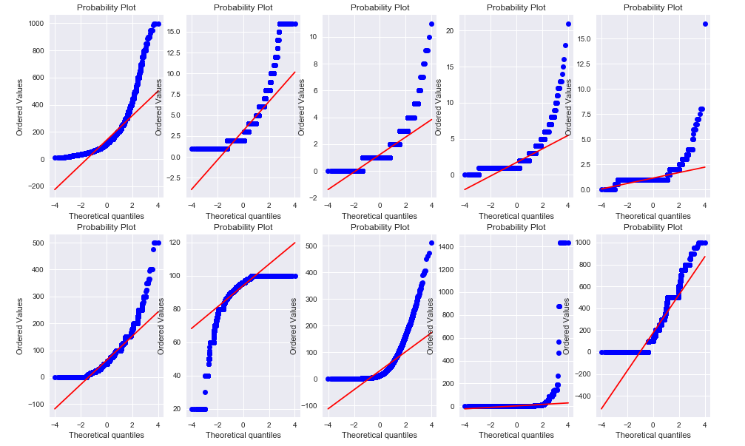
Best House-type
We draw the QQ plot of original dataset:
Data
cleaning
Data
normalization
Model
training
Parameters
weights
Price, accommodates, bedrooms, beds, bathrooms, cleaning fee and numbers of reviews are skewed right.
Review scores rating is skewed left.

Slide 9
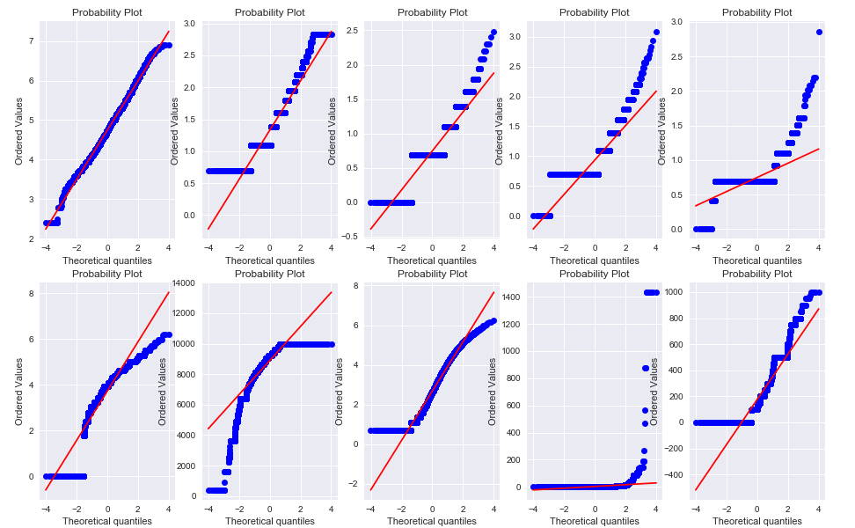
Best House-type
Step 1: Transfrom dataset o remove skewness
Data
cleaning
Data
normalization
Model
training
Parameters
weights
Step 2: Standardize data set to make all variables between 0 and 1

Slide 10
Best House-type
Perform linear regression between price and all possible factors:
price = 0.195 × accommodates + 0.170 × bathrooms
+ 0.123 × bedrooms + 0.080 × review scores rating
+ 0.036 × cleaning fee + 0.035 × security deposit
+ 0.028 × beds - 0.012 × numbers of reviews
+ 0.001 × host listings count
Data
cleaning
Data
normalization
+ ∑aᵢɪ(neighbourhood = neighbourhoodᵢ)
+ ∑bᵢɪ(room type = room typeᵢ)
Model
training
1 if x=c
ɪ(x=c) =
aᵢ is the coefficient related to neighbourhoodᵢ
bᵢ is the coefficient related to room typeᵢ
⎧
⎩
Parameters
weights
0 otherwise

Slide 11
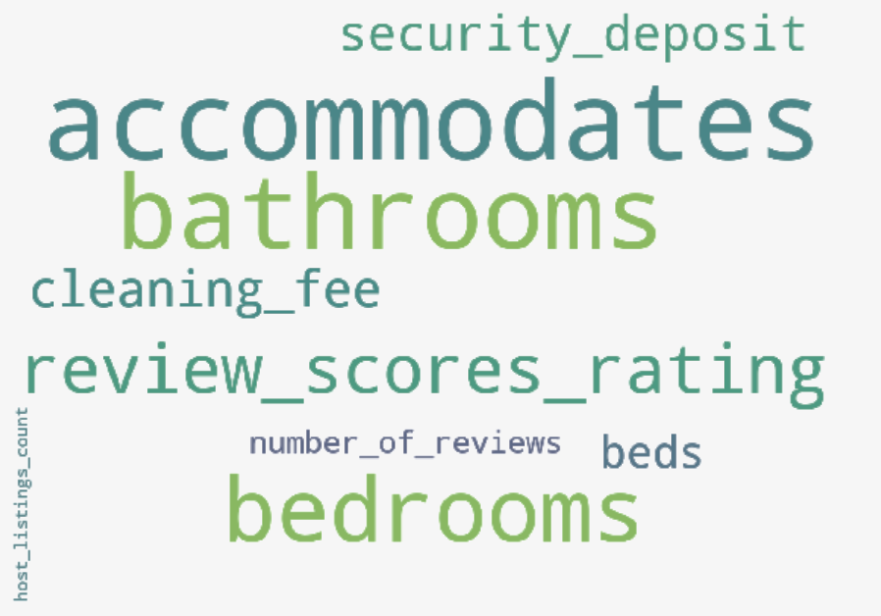
Best House-type
Draw the word cloud of all possible factors regarding to the absolute value of their parameters:
Data
cleaning
How many people can settle in the house matters more than the number of bedrooms. Maybe put a full-size bed or high-low bed is a better choice than a twin-size bed.
The review scores of rating is also important for the price.
Guests cares little about total number of listings a host has.
Data
normalization
Model
training
Parameters
weights

Slide 12
Best House-type
Draw the word cloud of all possible factors regarding to the absolute value of their parameters:
Data
cleaning
 | House-A | House-B
Accommodates | 3 | 2
bedrooms | 1 | 2
price | 61 | 59
Data
normalization
Model
training
beds:2
bathrooms:1
cleaning_fee:40review_scores_rating:9 number_of_reviews:173
host_listings_count:10,
security_deposit:0 neighbourhood:Harlem
room_type:Private room
Parameters
weights

Slide 13
How to maximize your profit?
01
Find Worthy Neighbourhood
02
Choose the Best House-type
03
Price Your House
04
Describe Your House
Notes:
13

Slide 14
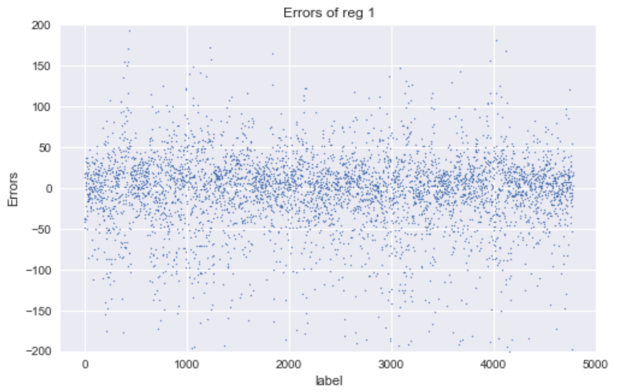
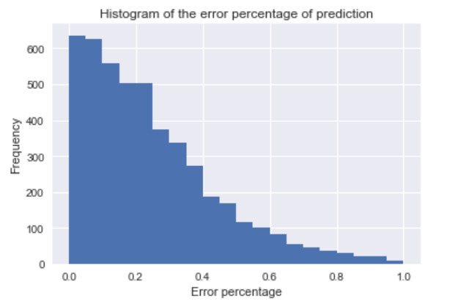
Price Your House
The error of price prediction on testing dataset with true price:
MSE = 0.33
70% of data prediction errors do not exceed 30%. The prediction is good.
MAP

Slide 15
How to maximize your profit?
01
Find Worthy Neighbourhood
02
Choose the Best House-type
03
Price Your House
04
Describe Your House
Notes:
15

Slide 16
Describe Your House
Goal: Attract Customers
Question: What attracts the customer?
Find the answer in the description of the popular house in Airbnb with the largest number of reviews per month.
Set two compare groups:
the rate of the house must be GREATER THAN 90, which means that they are good house.
The number of the two set is the SAME for 200.
The first group has reviews number as least 7 per mon.
The second group is the 200 houses which has the lowest number of reviews per mon.

Slide 17
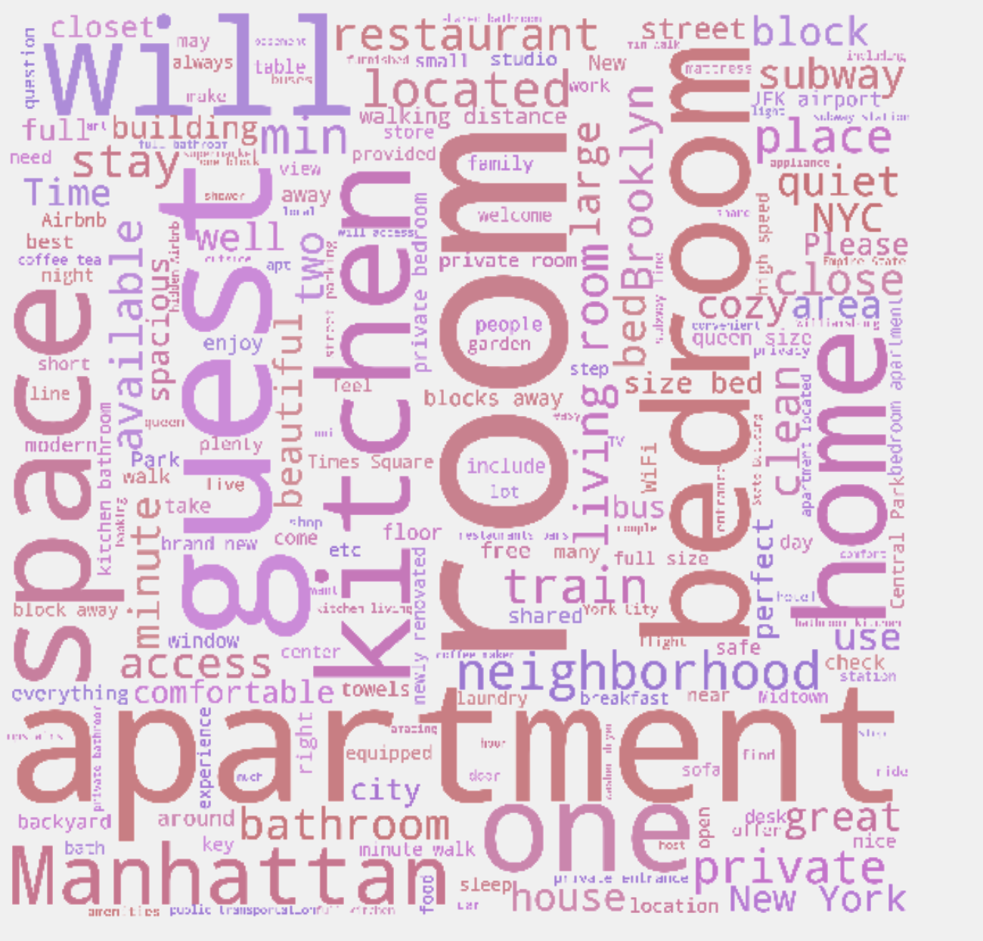
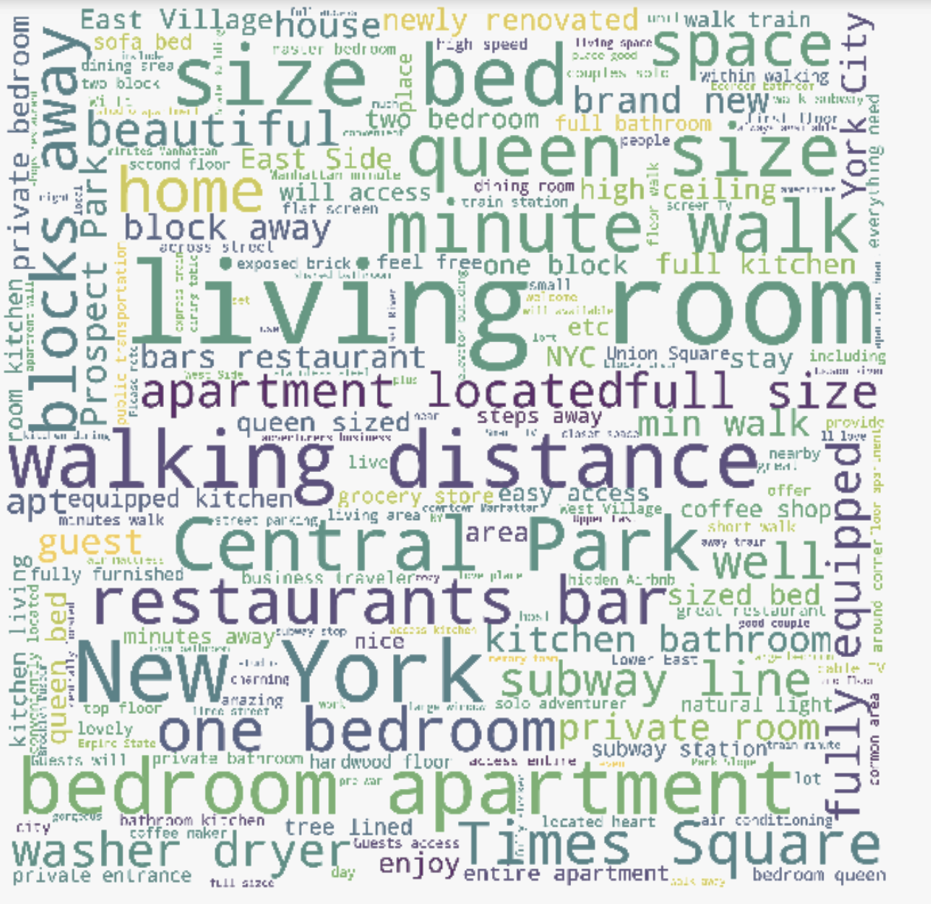
Describe Your House
Focus on describe the details of room and emphasis on making the guest feel at home.
Have a lot descriptions of the neighborhood and do not focus on something.

Slide 18
Summary
1
Find Worthy Neighbourhood
Belle Harbor is the best neighbourhood.
2
Choose the Best House-Type
Accomodates is the most important factor.
Price Your House
Use the regression model to predict the price and adjust it according to the map.
3
4
Descript Your Home
Try to describe your house’s details and emphasis on that you will make them feel at home.
And Make Money!

Slide 19
THANK YOU
Notes:
19

